Slide 1
The Bitcoin Blockchain
Jordan, Frederic, Peter, and Owen
Notes:
Jordan

Slide 2
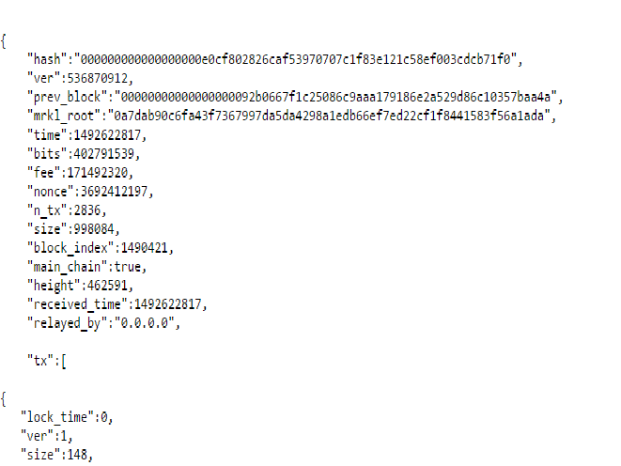
The Blockchain “Database”
The Blockchain is not a Relational Database but rather a long series of JSON objects comprised of blocks.
As of April 19, 2017 there were ~462,591 blocks.
Each block is a JSON object of approximately 175,000 lines
The size of the database is 111 GB as of April 19, 2017
Our challenge is to extract only 4 lines from each block and store it a format that is analysis ready
Notes:
Jordan

Slide 3
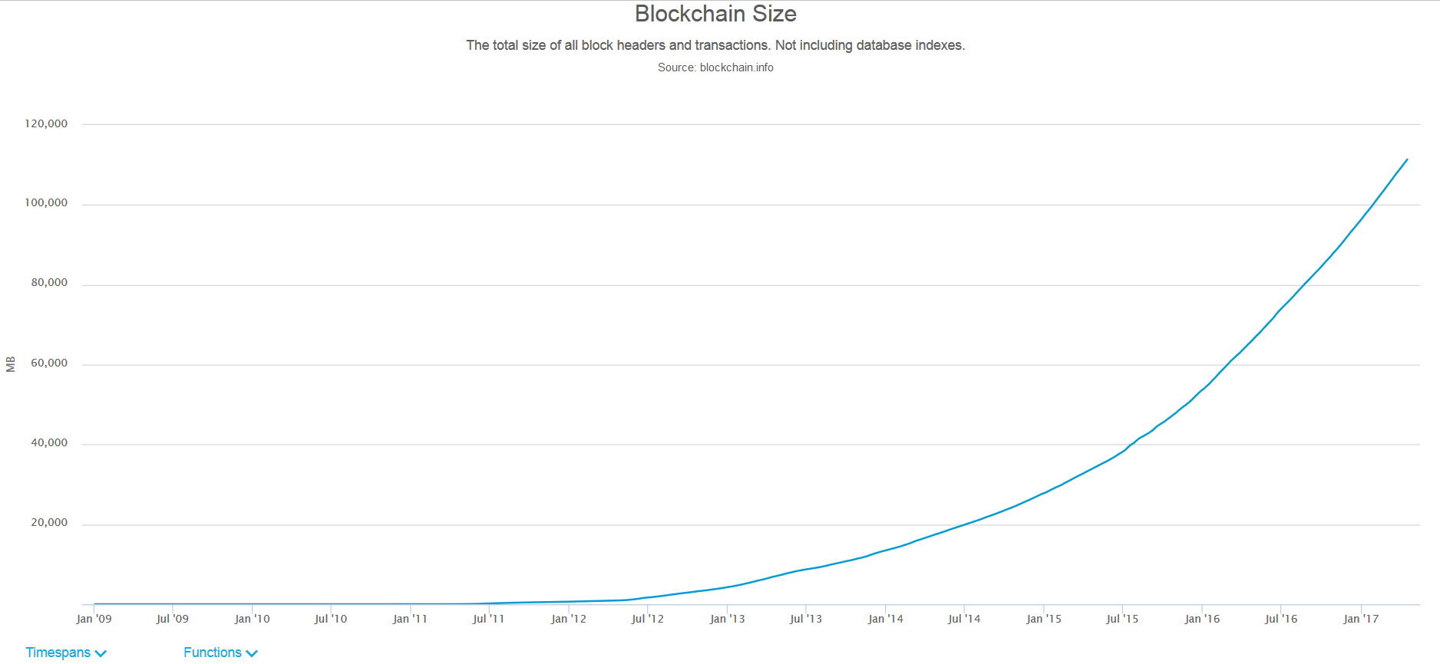
The blockchain is growing every day
Notes:
Jordan

Slide 4
The GDELT Project
GDELT is the largest, most comprehensive, and highest resolution open database of human society ever created.
Monitors the world's news media and stretches back to January 1, 1979 through present day with daily updates
Required an unprecedented array of technical and methodological innovations, partnerships, and whole new mindsets to bring this all together and make it a reality.
Notes:
Jordan

Slide 5
Mission
We hope to analyze bitcoin transaction volumes and look for spikes and troughs to see how they are associated with news events in GDELT
Data Sources:
GDELT data is available on Google BigQuery
Bitcoin blockchain chain be derived from https://blockchain.info/
Notes:
Jordan

Slide 6
Initial Architecture/Topology
Batch Load
Postgres
CSV Dump
Find Missing
BigQuery
Streaming Updates
Tableau
Notes:
Peter

Slide 7
Advantages
Colocation -- no network latency to postgres
Sandbox -- can test locally before deployment
Inexpensive -- don’t pay per query for sandbox
No duplicate rows
Concerns
Missing Blocks
Multiple steps
Long running -- 22 hours for 9 years of history
Notes:
Peter

Slide 8
Architecture/Topology
At least once processing
Batch Load
Bigquery Temp Table
De-dupe
BigQuery
Streaming Updates
Tableau
Notes:
Peter

Slide 9
Advantages
Advantages
Fewer steps
Faster -- 1 hour for 9 years
Flexible Backfill
Concerns
Network latency -- addressed with multithreading
Cost -- surprisingly inexpensive
Less robust -- needs monitoring
Duplicate rows -- needs dedupe
Notes:
Peter

Slide 10
Discussion
Why not Spark?
Processing underlying bigquery provided the heavy lifting we need
Python was simpler to implement and satisfied our design goals
Why not Storm for streaming?
Update volume is low (~1 new block/10 minutes)
Similarly, python was simpler and satisfied our needs
In both cases, the processing and development overhead of additional frameworks wasn’t worth the increase in scalability or speed.
Notes:
Peter

Slide 11
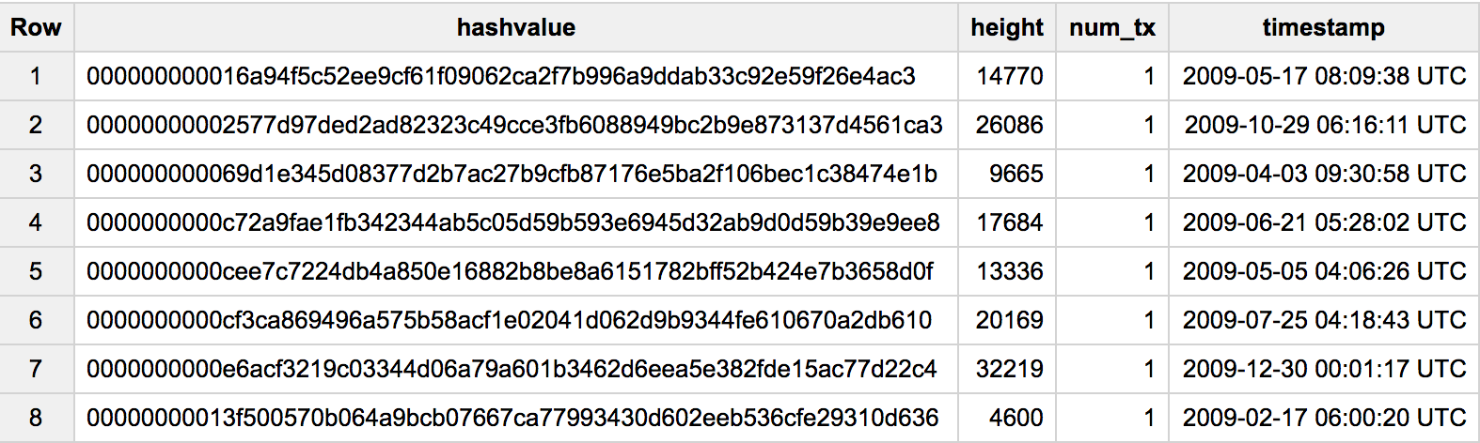
Bigquery Schema
Notes:
Jordan/Peter

Slide 12
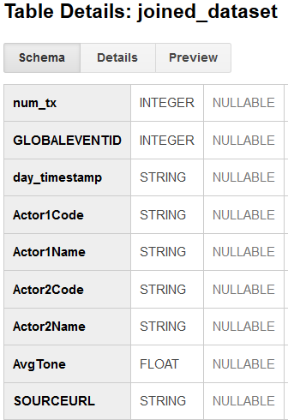
Technical Summary
Multithreaded python app to retrieve the blockchain
Faced a few small snags:
Orphan Blocks
Streaming script to look for new blocks every 10 minutes and update bigquery
GDELT table is readily available in bigquery
Joined the two tables
Queried again to remove outlier dates and count average tone by actor code
Used Tableau to visualize analysis results.
Notes:
Peter/Frederic

Slide 13
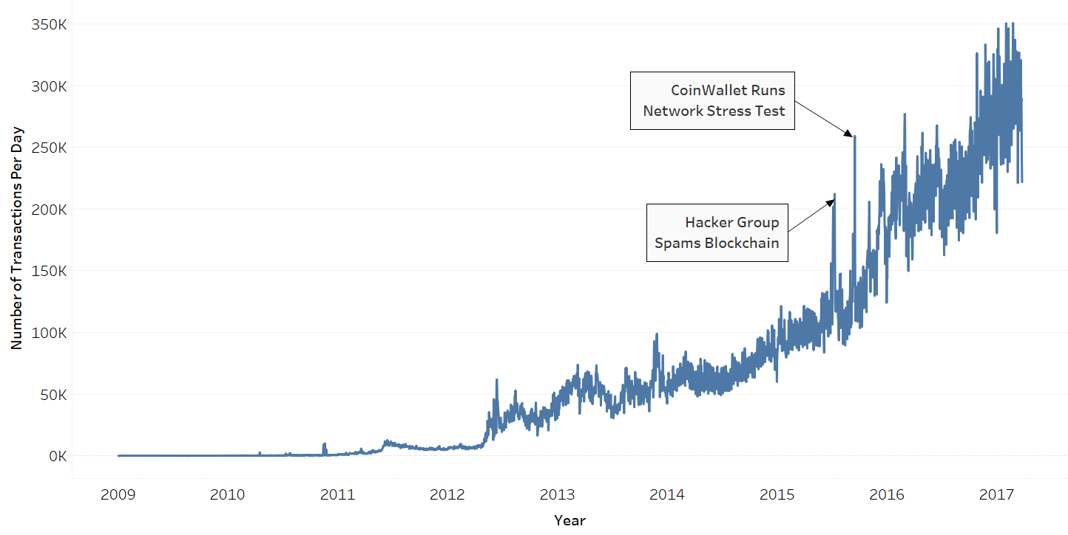
Outliers in the Data
Notes:
Frederic
Note from Owen:
Since we haven’t yet introduced the idea of day over day or key actor analysis, I wouldn’t go into the such detail as you’ve outlined below because I don’t think the audience will understand what you are talking about. You can just say something like “removing these days impacted our analysis and gave us more faith that our results were not biased by these artificially high transaction periods”. Just my two cents.
Removing these events “affected it on the margins but not dramatically. for example, ISRAEL was still a term that was mentioned more often on decrease days, but differences for other terms such as MUSLIM, TURKEY, and CONGRESS saw their differences increase while NEW YORK and FRANCE saw differences decrease” (thank you Owen!)

Slide 14
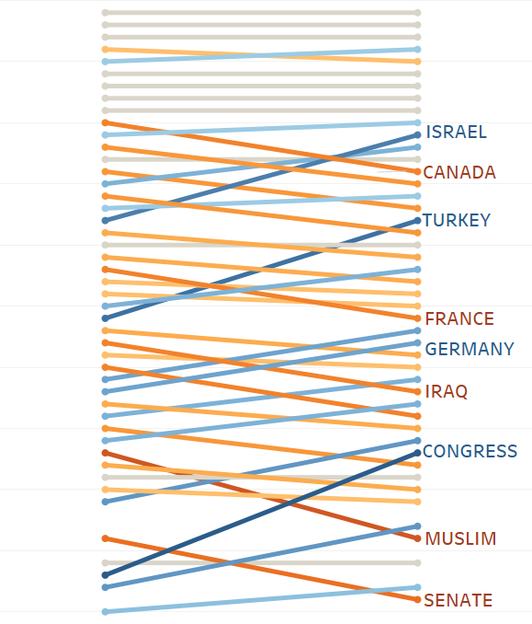
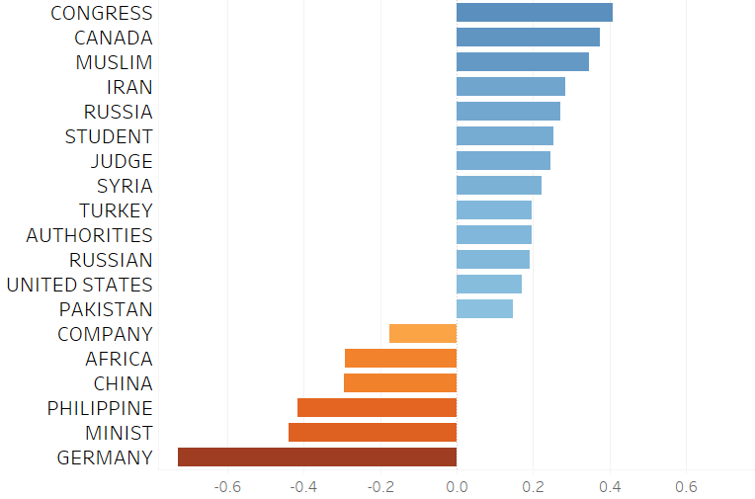
Day Over Day Delta Analysis
On days when Bitcoin transaction volume increased/decreased most, we examined the most common actors referenced in the news and the tone of the coverage.
Differences in Primary Actor Rank
Differences in Primary Actor Sentiment
1st
50th
Increase Days
Decrease Days
More Positive on Increase Days
More Positive on Decrease Days
Notes:
Owen

Slide 15
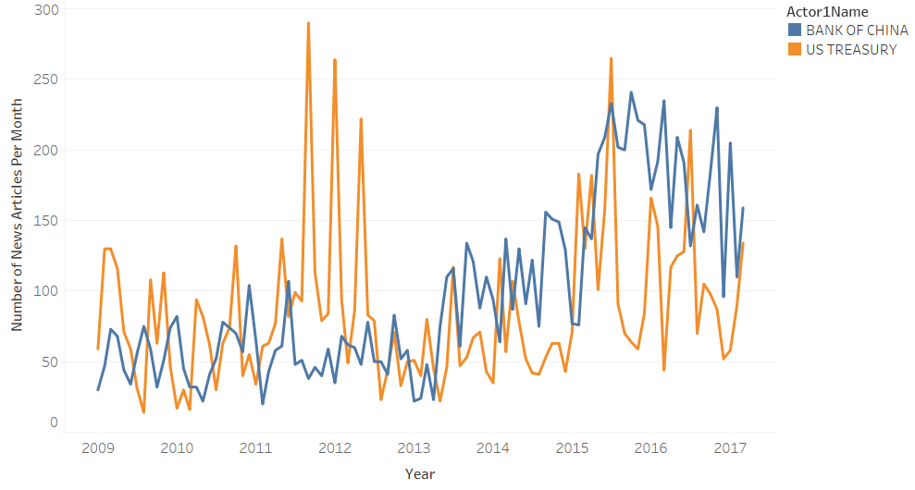
Key Actor Analysis
For two actors we expected to impact Bitcoin transaction volume the most, we examined the deltas for days when these actors were mentioned most often.
Frequency of News About Key Actors
Key Actors and Average Transaction Deltas
US Treasury Top 10 Days | +125
Bank of China Top 10 Days | -3182
All Days | +2
Notes:
Owen

Slide 16
Possibilities for Future Research
Use larger time periods for analysis on deltas such as 3 days or 1 week
Look at top 20, 50, and 100 increase/decrease days for comparison
Examine trends in overall sentiment in relation to transaction volumes
Utilize time series models to control for cyclical effects on transactions
Incorporate geographical data in GDELT to look at trends in certain regions
Add price data to examine price trends and weight transactions by price
Implement machine learning algorithms to predict future transaction volumes
Notes:
Owen

Slide 17
Questions?
Notes:
All

